Slide 1
DIA OF TWITTER –FORD
NANI ATLURI

Slide 2
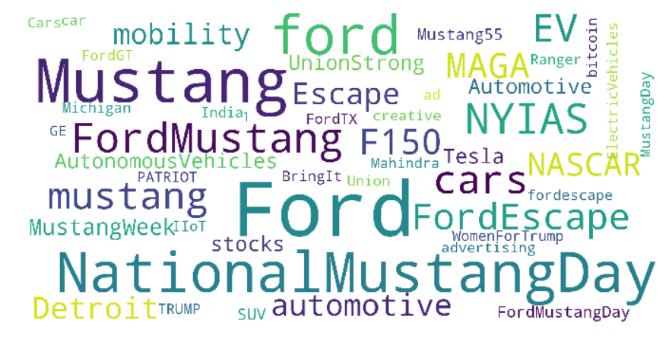
cONTENTS
Data overview
Extracted data
Insights
Top Hastags seen in data

Slide 3
Data
Scope: Collect data to create Single Complete Actionable View – Twitter
Who…what…where…sentiment…location…context of a tweet
Unique identifier for tweet and users
Is the tweet a response to another tweet/user ?
Where did he tweet from?
Data collected?
‘user_id', 'user_name', 'user_screen_name', 'user_default_profile', 'user_profile_image_url_https', 'user_location', 'user_url', 'user_description', 'user_has_extended_profile', 'user_protected', 'user_verified', 'user_followers_count', 'user_friends_count', 'user_listed_count', 'user_favourites_count', 'user_statuses_count', 'Tweet_created_at', 'Tweet_id', 'Tweet_source', 'Tweet_in_reply_to_status_id', 'Tweet_in_reply_to_user_id', 'Tweet_in_reply_to_screen_name', 'Tweet_contributors', 'Tweet_retweet_count', 'Tweet_favorite_count', 'Tweet_possibly_sensitive', 'Tweet_lang', 'Tweet_polls', 'Tweet_coordinates', 'Tweet_place', 'Tweet_country', 'Tweet_full_text'

Slide 4
Extracted data
Hashtags', 'tag', 'Tweet_text_emoticons', 'Car_related', 'Ford_Model', 'pos', 'neg', 'neu', 'comp’, 'emoticons', 'emoticon_pos', 'emoticon_neg', 'emoticon_neu', 'emoticon_comp’, 'Tweet_full_text_extracted', 'Influencer', 'trending'],
Did the tweet contain hashtags, emoticons?
Are there any car related words? Example F150 with “leakage”
Are there any ford models mentioned?
What is the sentiment of the tweet?
Is he an influencer ?
Is the tweet trending?

Slide 5
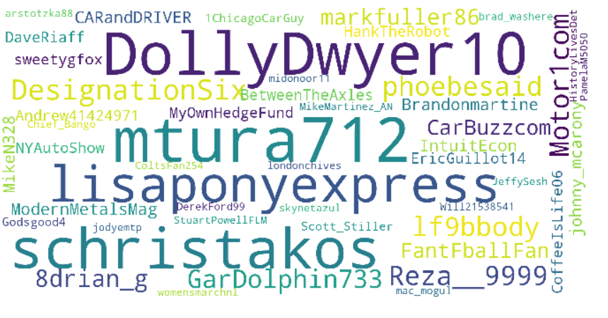
Insights
4 Weeks of data
19987 tweets
From 12984 users
Replies to Status: 6178
Replies to user:3894
Tweets by Ford*:232
Replies by Ford*:103
March 21st 2019
to
April 29th 2019

Slide 6

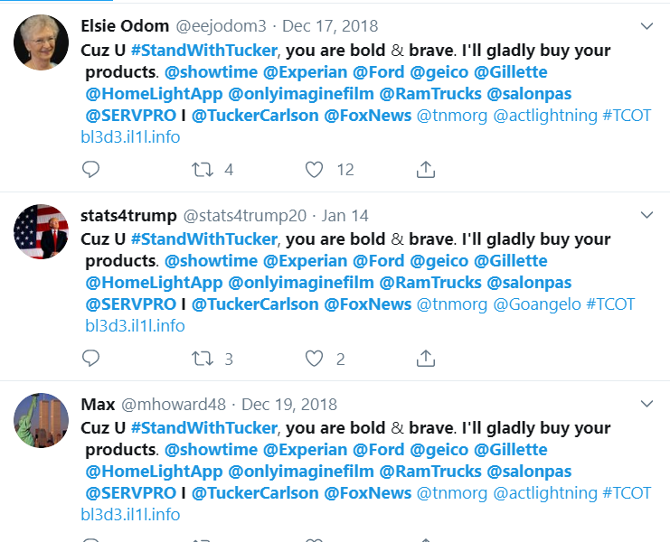
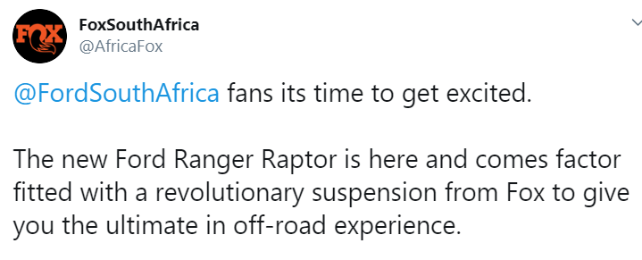
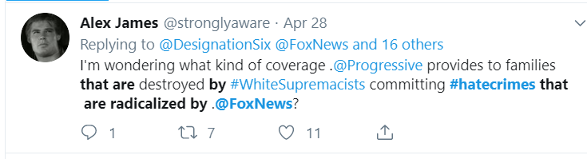
Anything surprising?
1178 tweet have Ford and Fox in the tweet
Some false positives

Slide 7
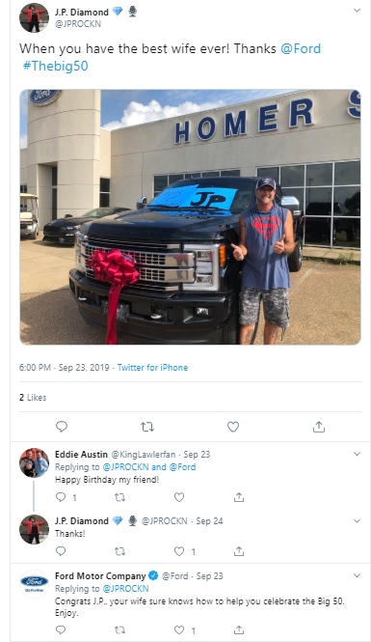
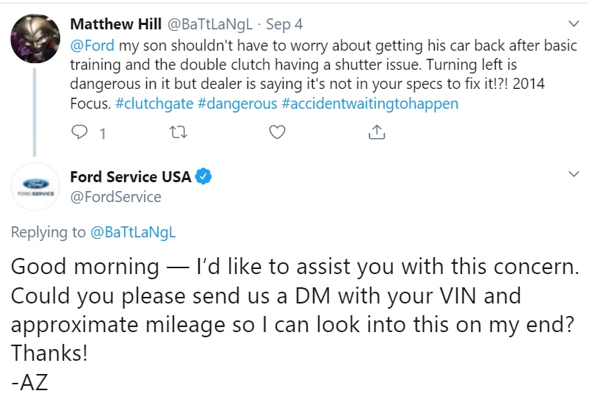
How is ford doing
Good in general
Data driven & Algorithm based approach
Time of tweet vs time when ford responded
How negative tweets are handled
Was there a conversation?
Are there any model specific issues?
Even a single tweet about a particular model is very valuable
Model:Focus
Issue: Clutch
How many other customers have complained about it?
Have we responded in time?

Slide 8
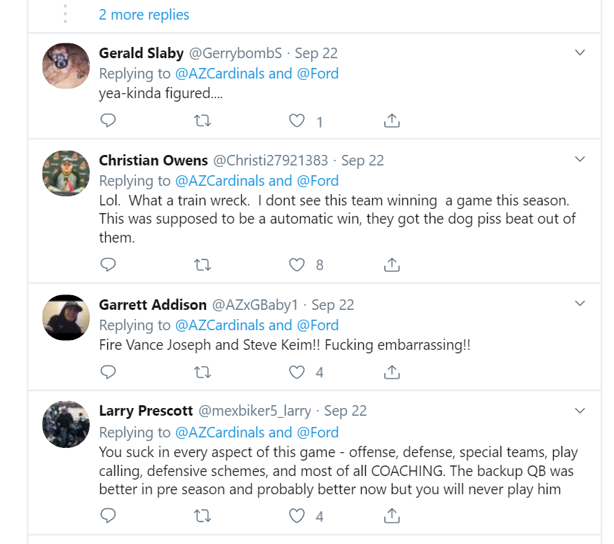
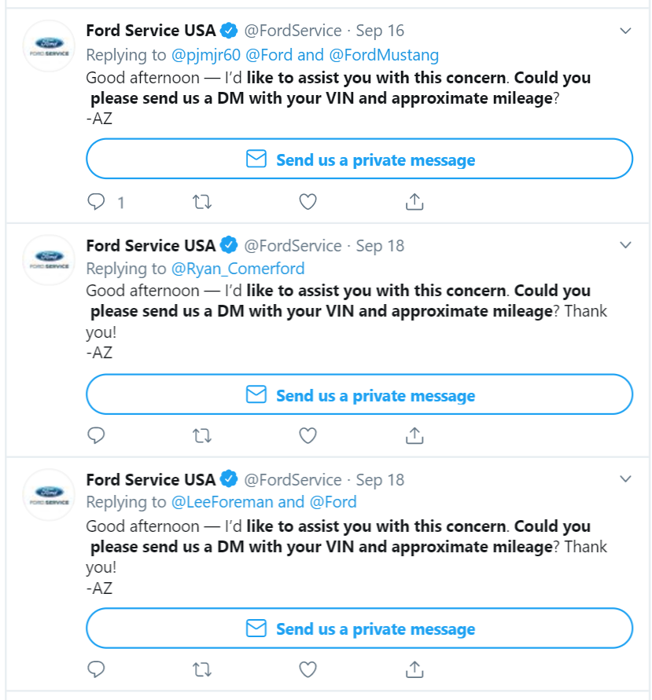
Ford sponsors AZ Cardinals
Gets tagged into unnessary conversation
These set of tweets have nothing to do with Ford
Az is using a templet to reply, it has its own disadvantages

Slide 9
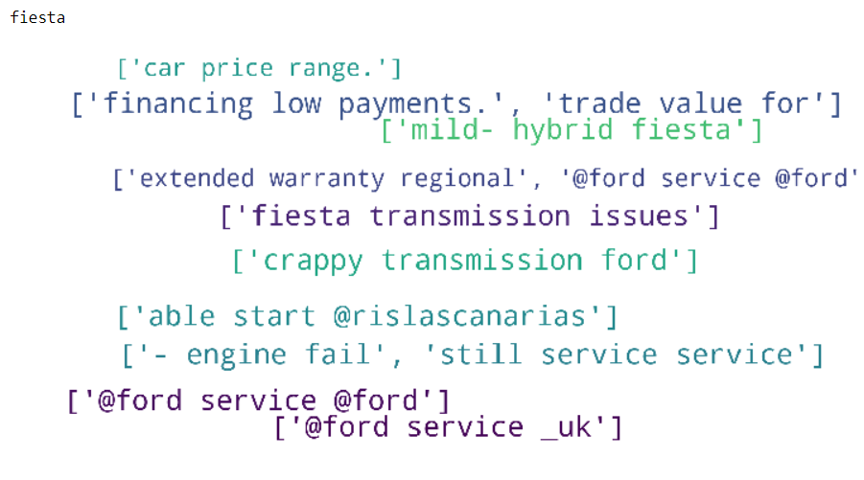
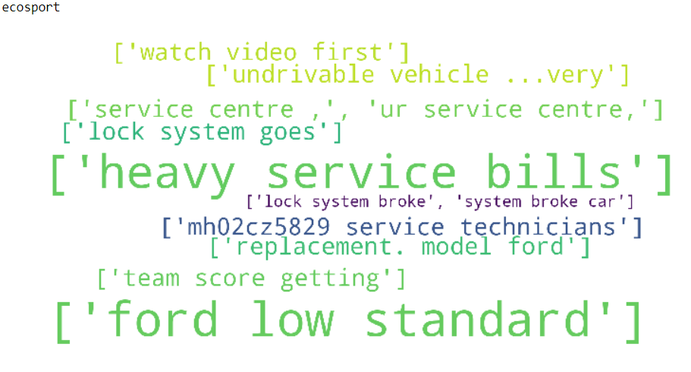
Version 1
Model related comments ->Car related word with preceding and succeeding words
Randomly picked comments

Slide 10
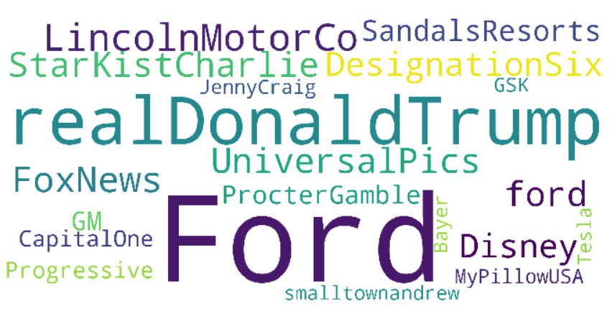
Who is tagged frequently with Ford?

Slide 11
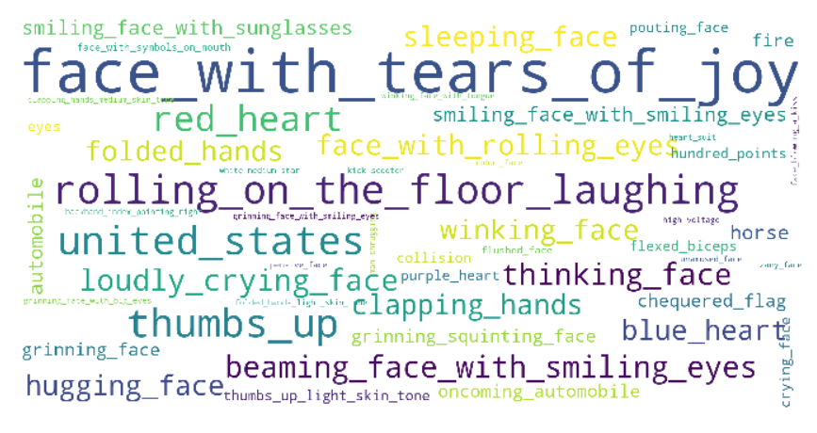
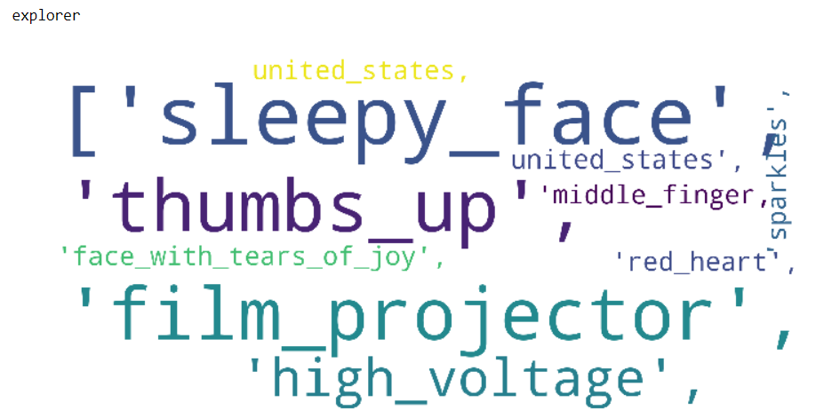
Which emoticons are used frequently

Slide 12
Moving Further
Improve the sentiment score
Automate data collection
Real time analysis of tweets
Analyze how Ford is handling the tweets
Analyze how Ford’s employees are responding to negative tweets
What are the issues with the car models
Example: Fiesta’s transmission issues
Which influencers are creating negative feedback
Net Impact for a campaign/sponsorship
Khoros/spredfast, digital roots engage,

Slide 13
Thank you
Laxmi Narayana Atluri
lnatluri@gmail.com
+1 2704210568
Linkedin:https://www.linkedin.com/in/laxmi-narayana-atluri-9a350665

